Slide 1
Trigger Processor Implementation
Nathan Felt
2015 May 4

Slide 2
Overview

Slide 3
ADDC GBT Data
BCID = 12 bit bunch crossing ID
HIT_CNT = 4-bit number of hits (range 0 - 8; 9 - 15 invalid)
ART_DATA = 6-bit triggered VMM strip number
ARTDATA_PARITY = 8-bit parity, one per hit
HIT_LIST= 32-bit list of flags corresponding to each of 32 VMMs. 0 - no hit, 1 - hit. A register controls if this is a filtered (i.e. 8 hits max) or an unfiltered copy of the VMM flags registered in a particular BC.

Slide 4
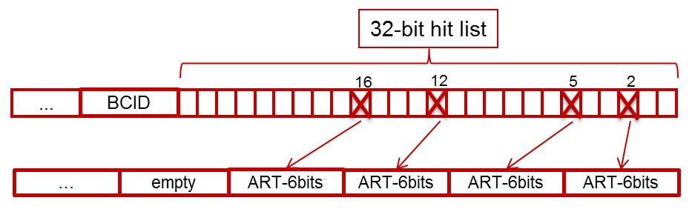
ADDC Hit List format

Slide 5
Trigger Processor Algorithm and Latency

Slide 6
Development Platform

Slide 7
Development Platform
Matlab used for all formatting, communication and analysis
Communication uses TCP/IP on Mircroblaze with AXI interface to Programmable Logic
ADDC Emulator lives in same FPGA
GBT Loopback with option to bypass
GBT implementation uses code from the CERN GBT-FPGA project
Initial data communication with BNL ADDC verified

Slide 8
Implementation
1/16th sector slice, containing all elements of algorithm implemented
No timing errors in algorithm
Extrapolated resource estimate 70%
Algorithm hardware results comparable to computer simulation
Currently working on increasing the bit resolution of some variables, This will likely increase latency by 6 – 9 ns
Source code on SVN

Slide 9
Ancillary functions
Ancillary functions common to both MM and sTGC can be shared as well-defined packages.
Ancillary functions Include
Timing and Trigger control (TTC)
Level-1 pipeline and derandomizer
read/write of configuration parameters
monitoring
playback for debugging
Segment output to Sector Logic
Segment output to “other” detector’s trigger processor
Three groups will participate in writing the firmware:
Harvard
Illinois
Weizmann

Slide 11
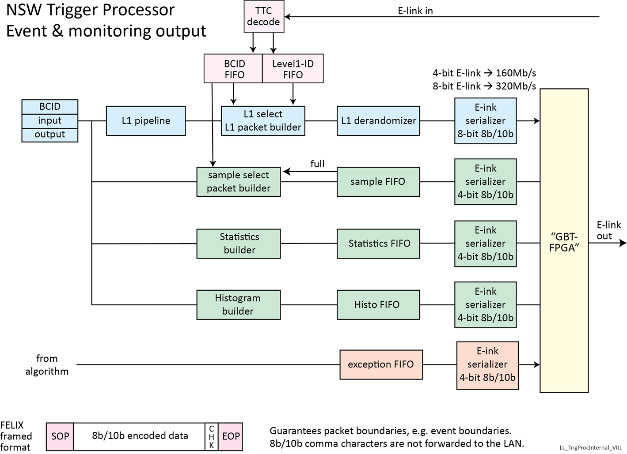
Backup

Slide 12
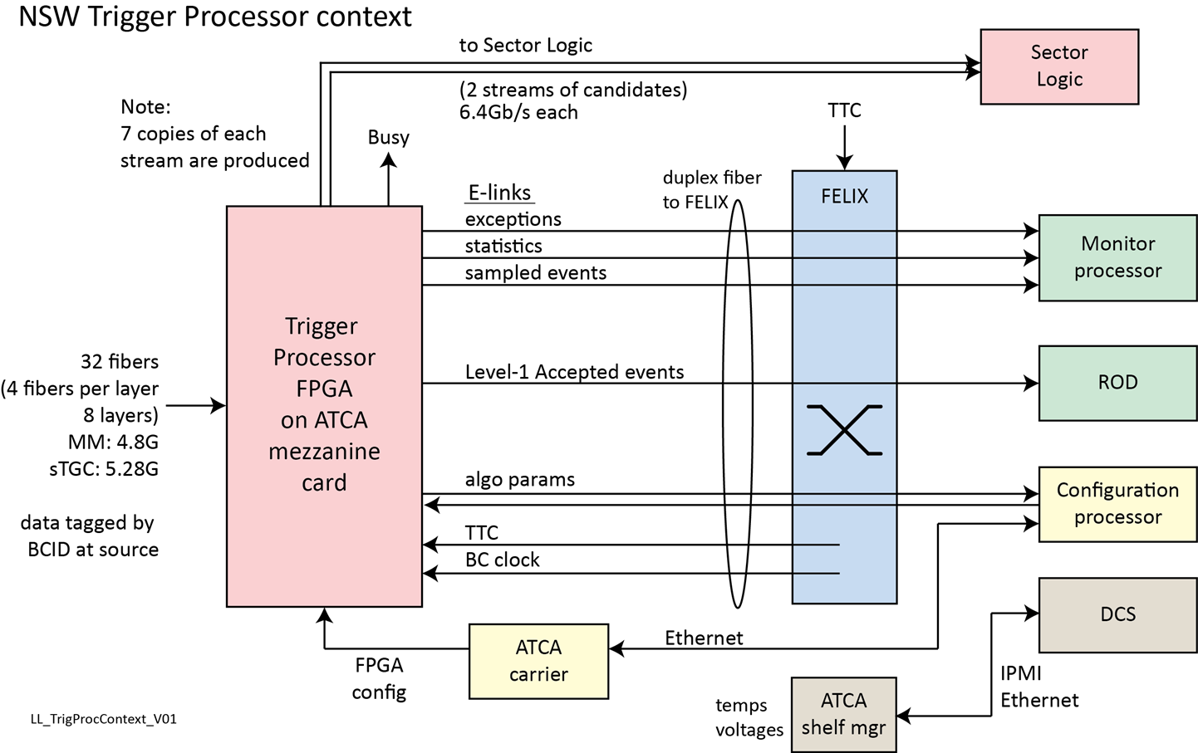
Backup

